Slide 1

ClubFinder
Group 82 The Clueless Four

Slide 2
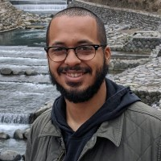
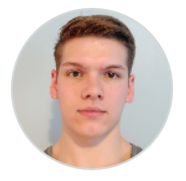
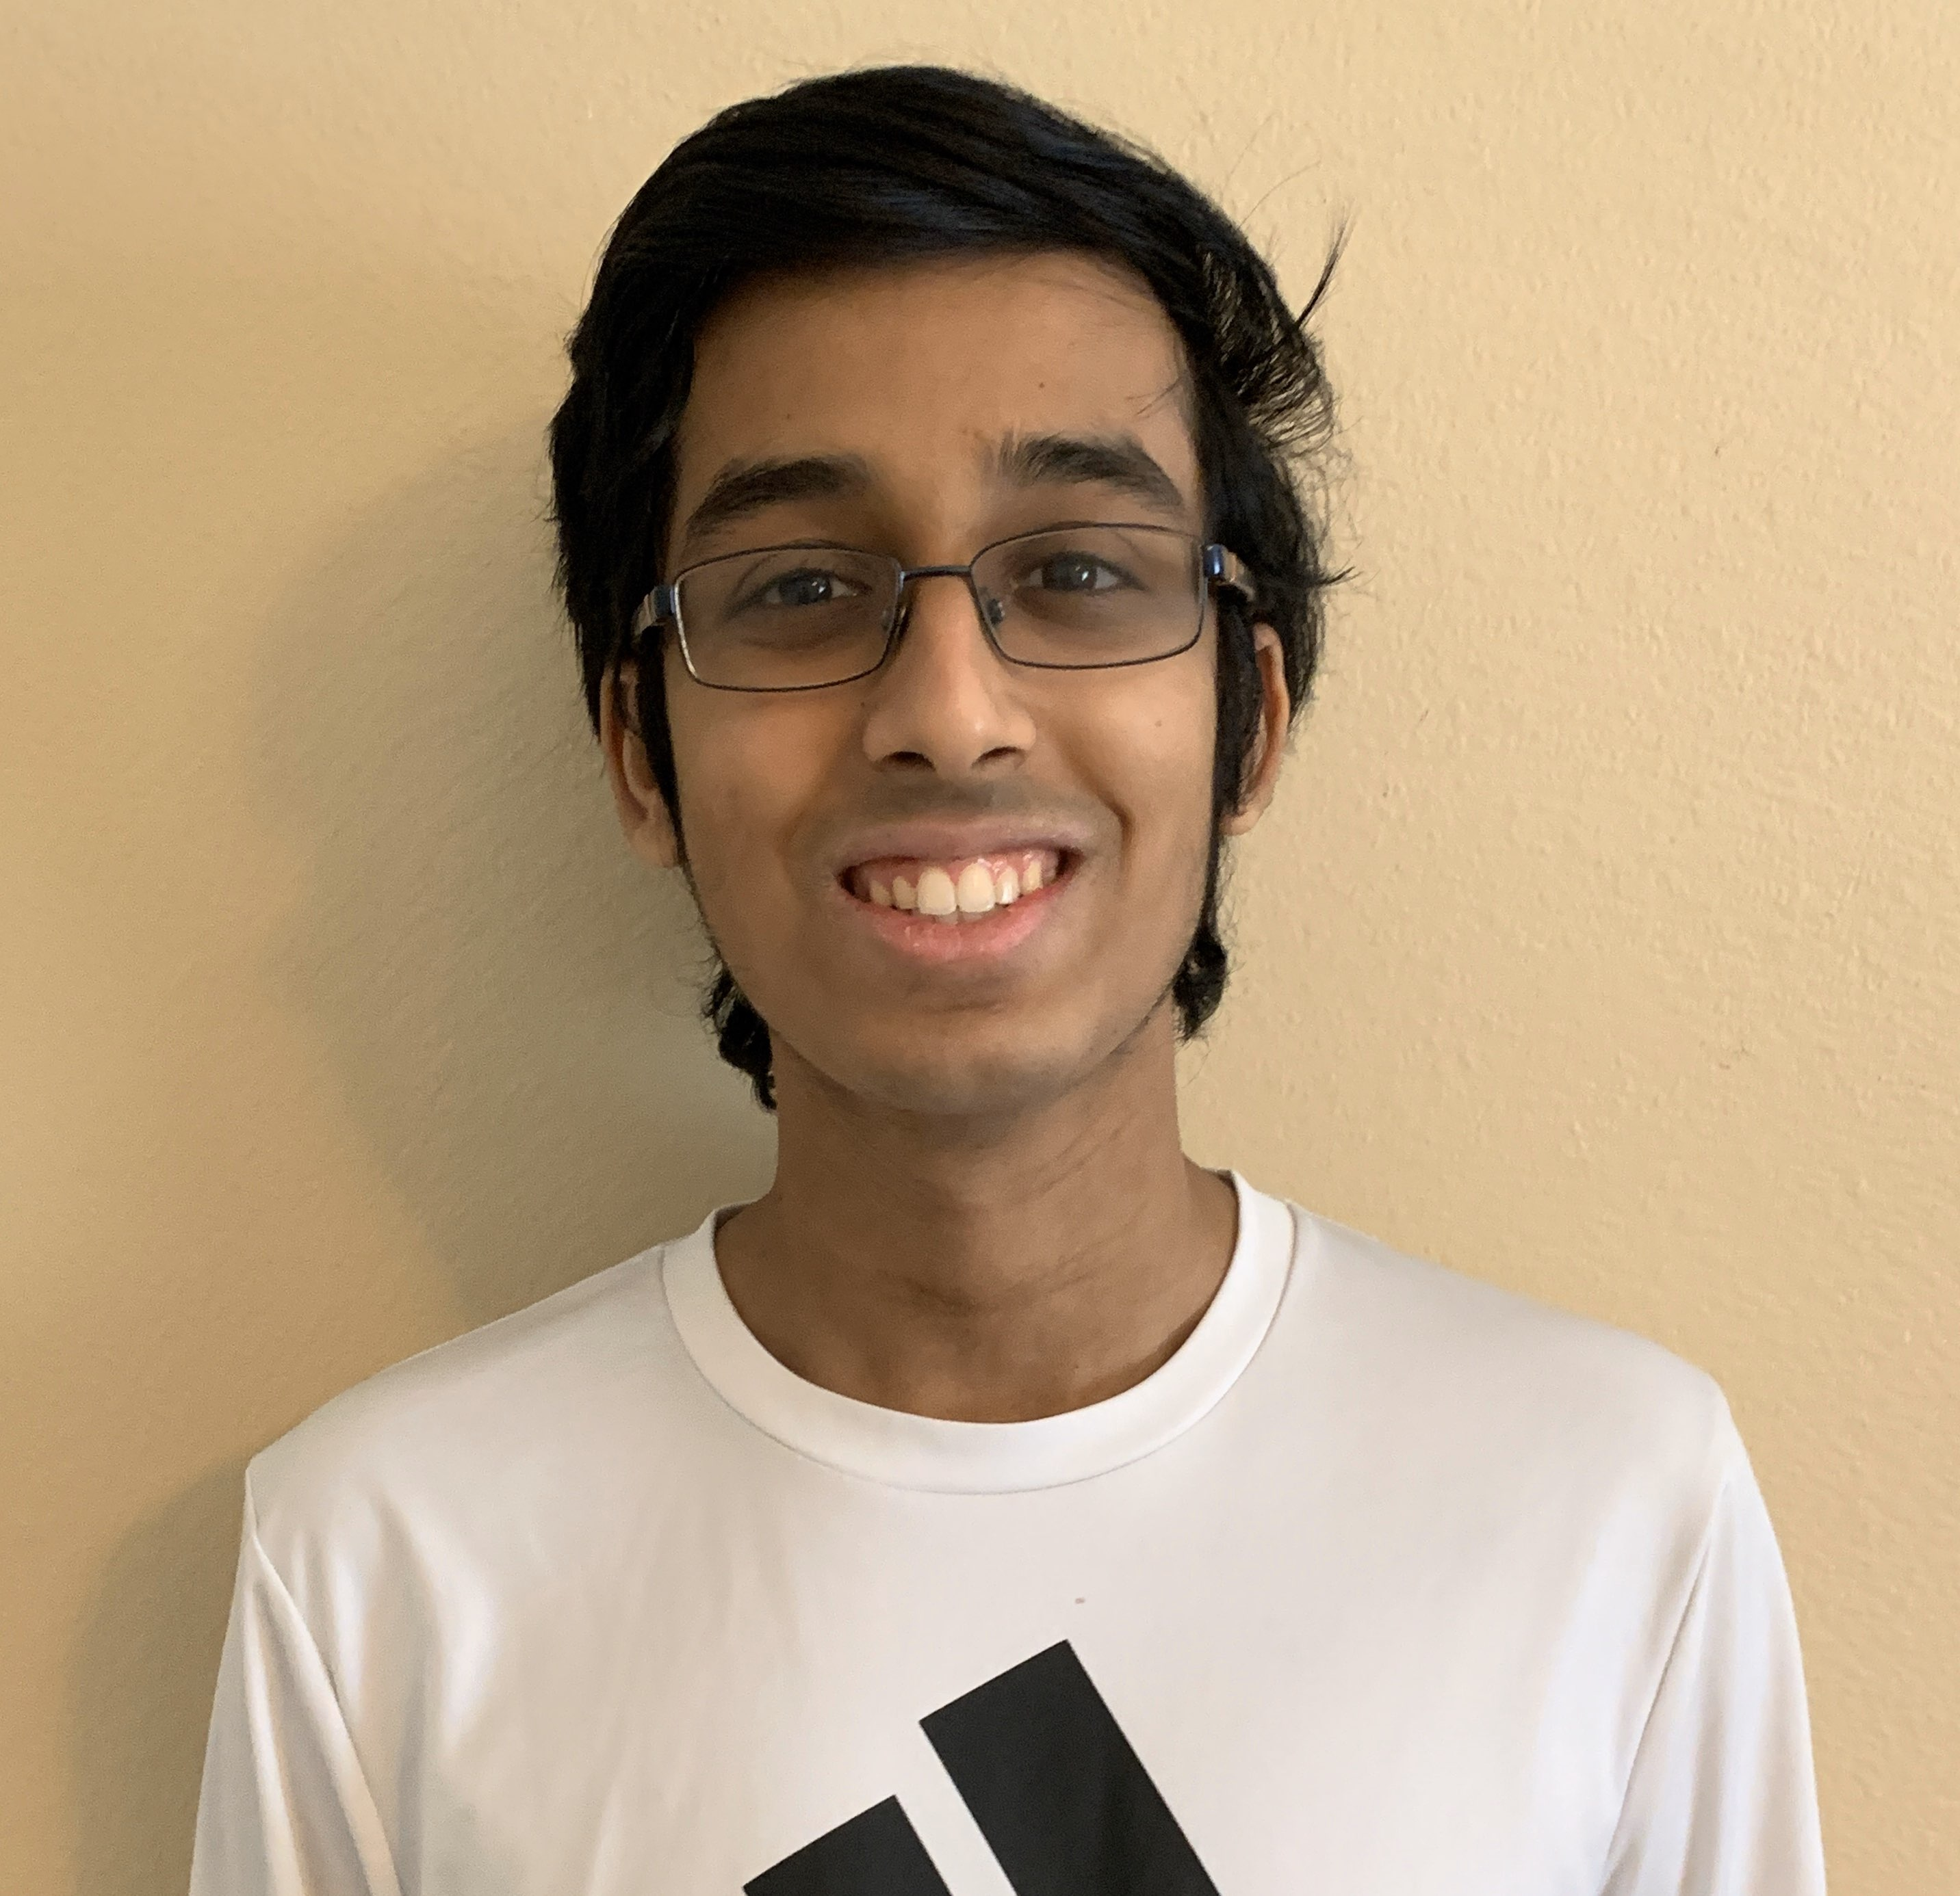
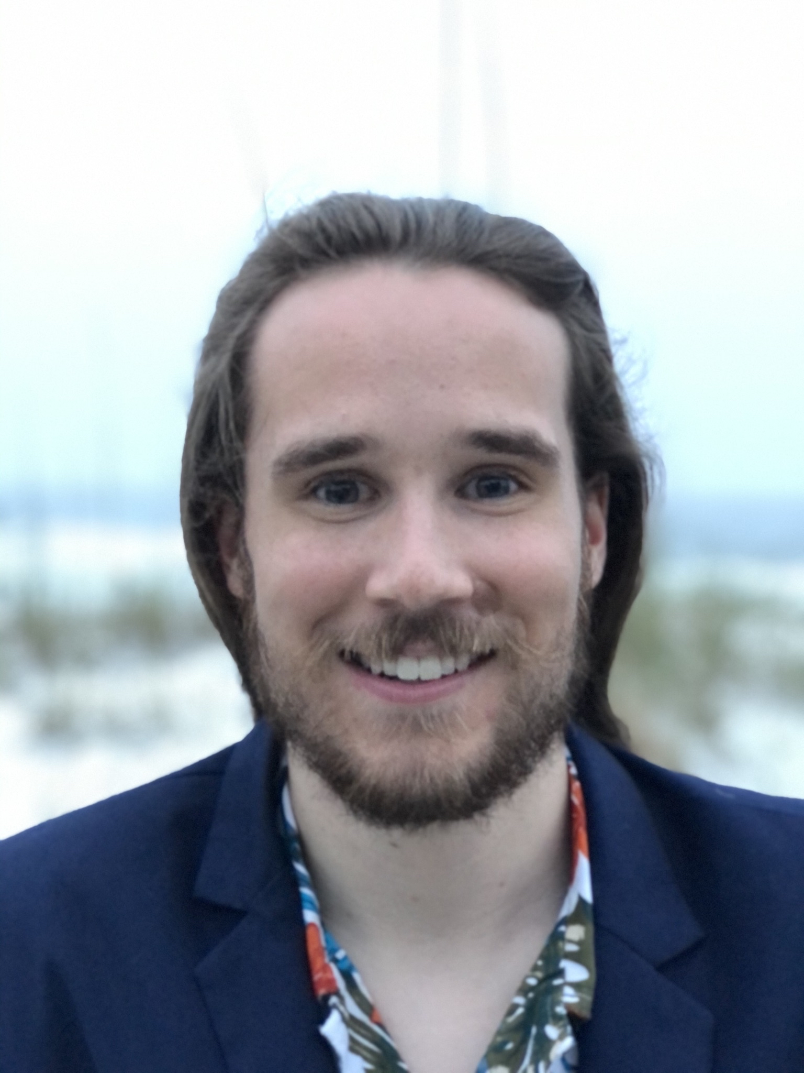
Team Members
Francisco Sanchez
Project Manager
Brandon Corbin
Scrum Master
Rohith Vellore
Developer
Joshua Garrett
Developer

Slide 3

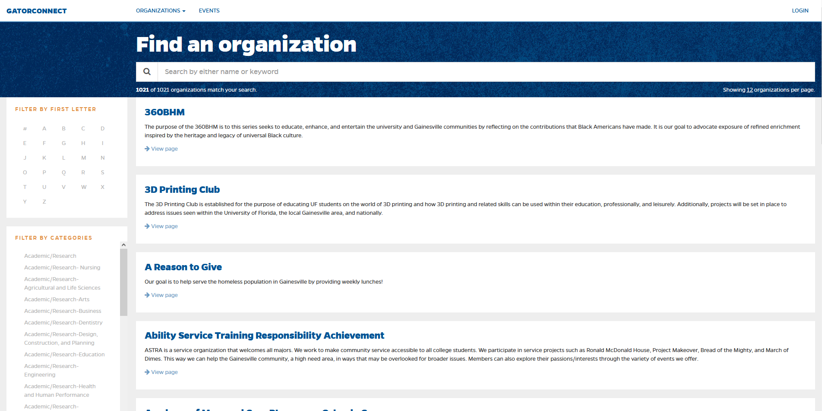
Problem Statement
The University of Florida promotes involvement in clubs. However, current club search does not aid the student in finding the best club for them.

Slide 4



Product Solution
This app will help students become more easily involved since the number of clubs can be overwhelming. It helps by allowing students to filter clubs based on their interests.

Slide 5
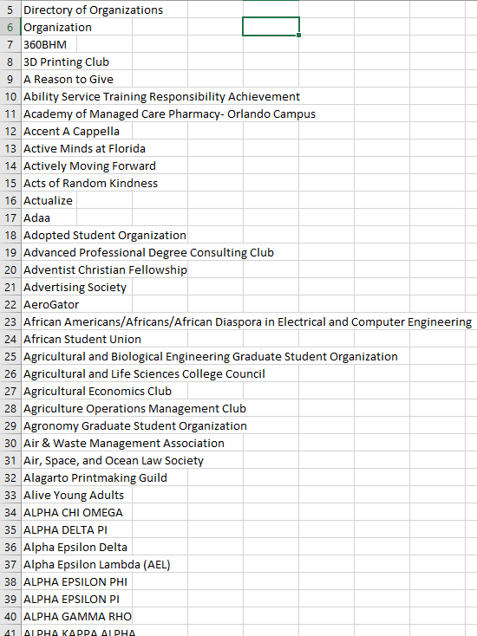
Work Completed
Gathered names of clubs

Slide 6

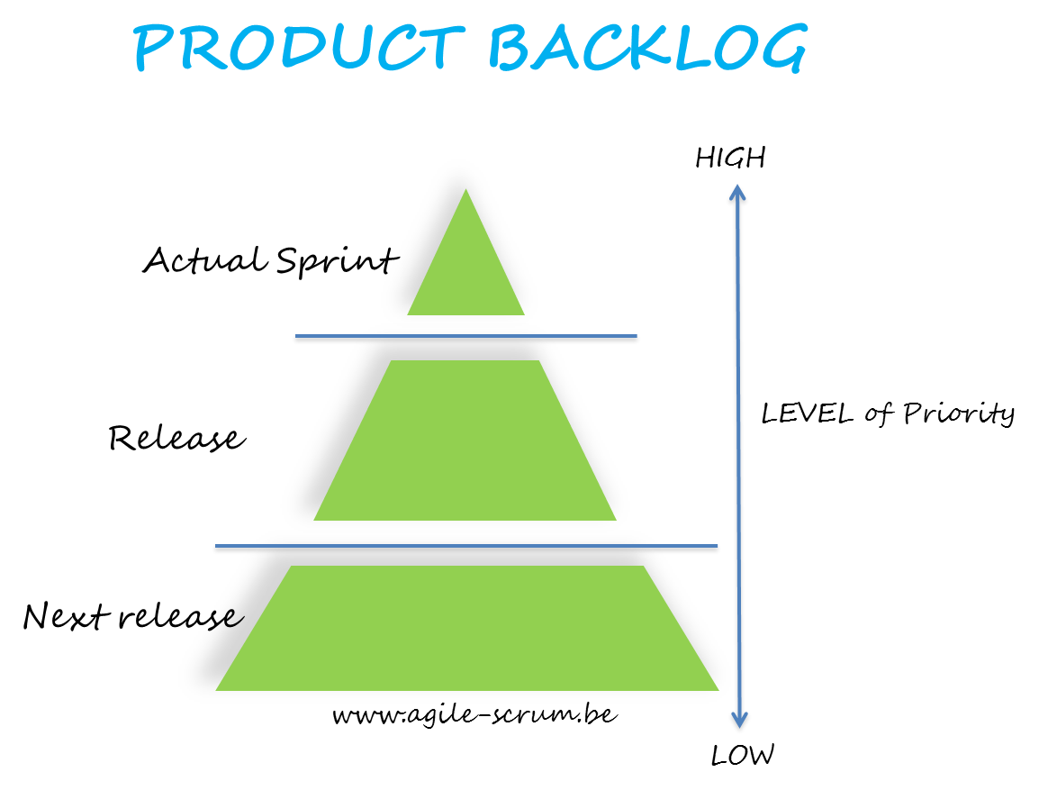
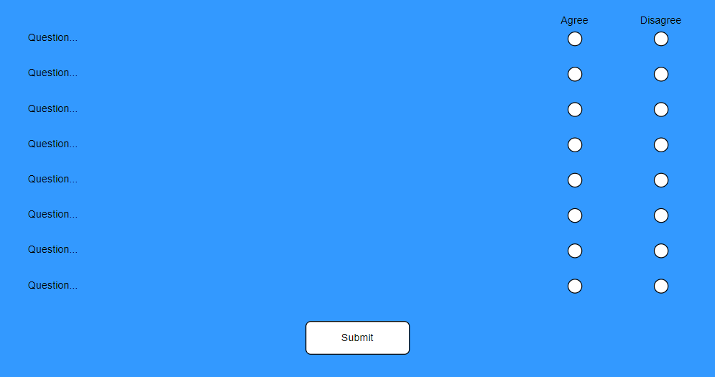
Review of Artifacts
MongoDB will be used as a database to store club names, description of clubs, and website if available.
Product backlog will be used to guide the design process.
HTML
JavaScript
CSS
Questionnaire web page design

Slide 7

Future Plans
Obtain the name, purpose, and website links for all UF clubs for storage in classes
Setup needed documents for website design
Create storage containers for club data as well as user responses to make it easy to retrieve them
Begin designing algorithm to pick clubs from the list based on user response
Start thinking of questions that would be effective in narrowing down the club options to a small amount for the user

Slide 8
Issues Encountered
None so far

Slide 9

Thank you
Questions?

